Slide 1
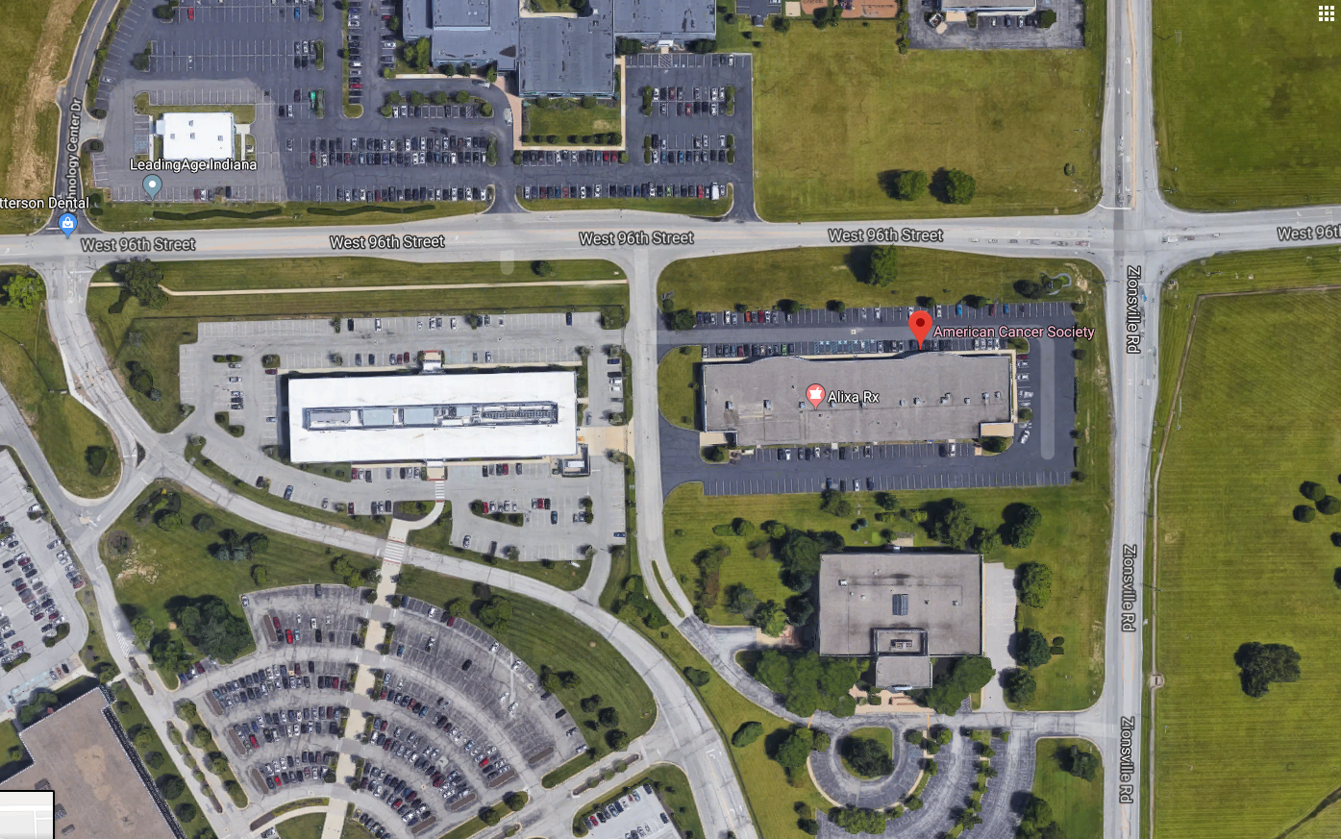
Building 312
5635 W 96th Street
312 Dock
9550 Zionsville Rd

