Slide 1

Vrsh
REFINING TECHNOLOGY

Slide 2


Process System & Controls, based in Houston, was created in 2018 in order to purchase and market this Vacuum Residue Slurry Hydrocracking (VRSH) process system.
A multinational oil corporation developed this VRSH technology and announced their plans to install the first unit in 2008

Slide 3
Background
After they developed the VRSH technology from 2003-2007, this equipment was going to be assembled into the first ever VRSH unit.
In 2009, the company decided to delay the project due to adverse economic conditions, and the equipment was never installed.

Slide 4
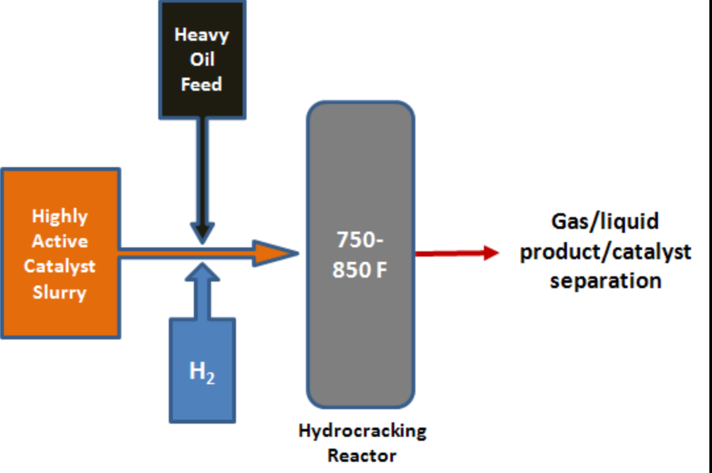
VRSH Process
Catalyst Slurry: The catalyst is prepared by first mixing an oxide of a Group VIB metal such as tungsten or molybdenum with aqueous ammonia. This is sulfided with hydrogen sulfide gas (H₂S) to form a slurry, which is then combined with a Group VIII metal compound such as nickel or cobalt.

Slide 5
Refining technology that converts ultra-heavy oil into clean-burning fuel
This process enhances a refinery’s capability to upgrade their ultra-heavy oil.
VRSH technology increased the yields of gasoline, diesel, and jet fuel from heavy and ultraheavy crude oil and upgraded production of heavy oil resources.
This technology achieves up to 100 per cent conversion of the heaviest feedstock, while delayed coking achieves less than 80 per cent conversion.

Slide 6
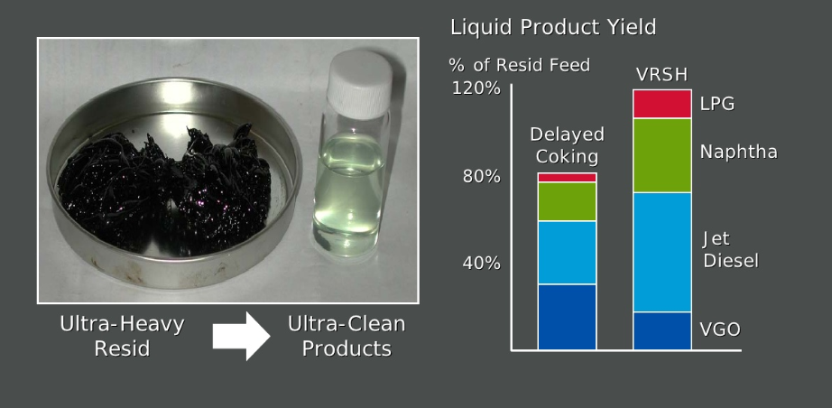

Slide 7
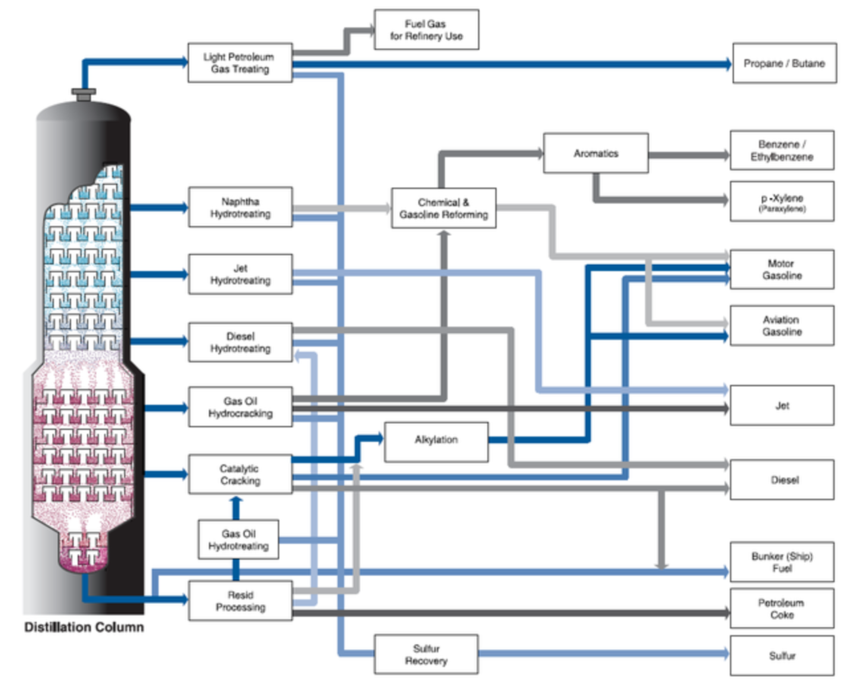
VRSH Applications

Slide 8
What is Imo 2020?
The International Maritime Organization (IMO) will enforce a new 0.5% global Sulphur cap on fuel content starting January 1st, 2020, lowering from the present 3.5% limit. The global Sulphur fuel cap is part of the IMO's response to heightening environmental concerns, contributed in part by harmful emissions from ships.
Installing this VRSH unit on a refinery process unit will produce marine bunker fuel that meets these new Sulphur regulations.

Slide 9
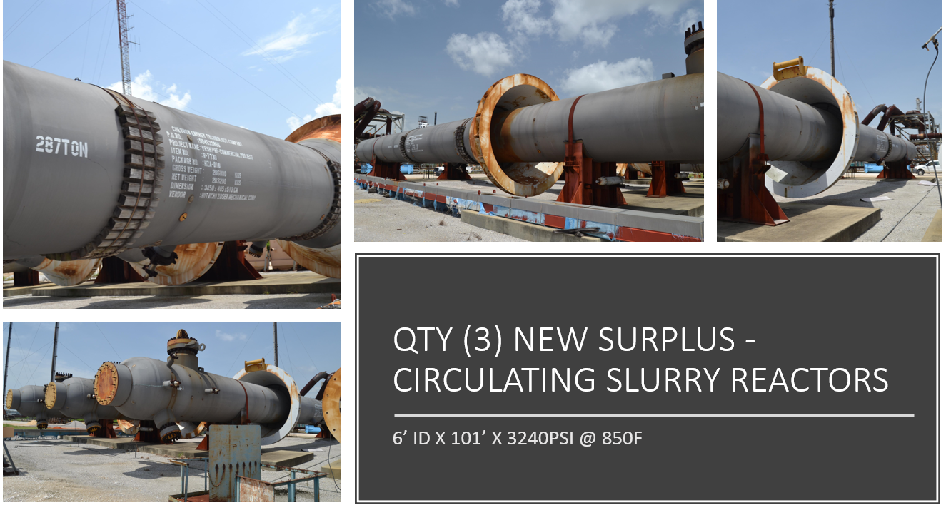
Surplus Slurry Reactors

Slide 10
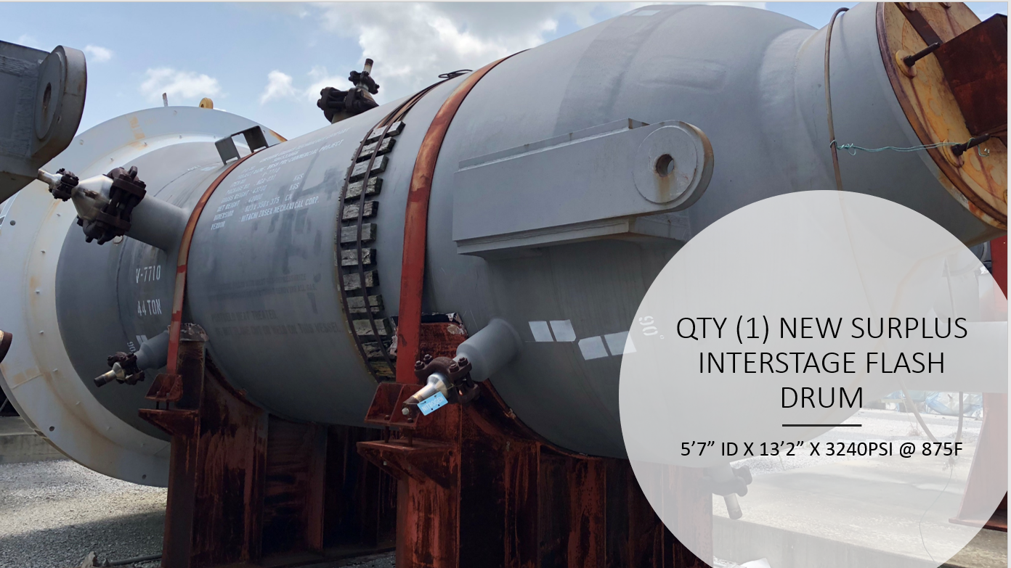
Surplus interstage flash drum

Slide 11
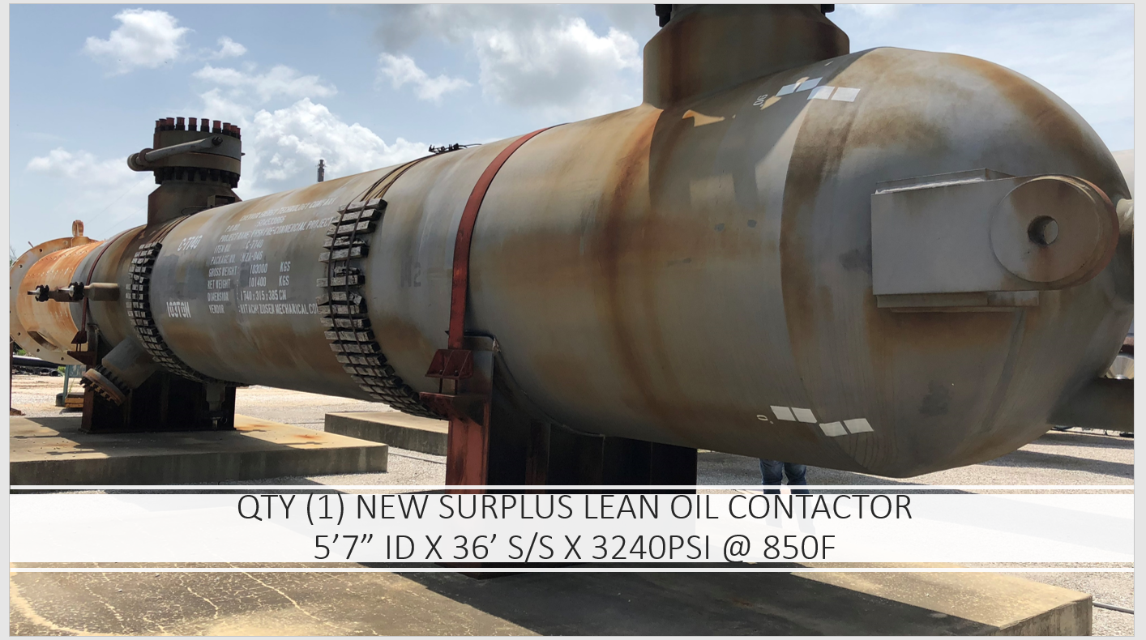
Surplus lean oil contactor

Slide 12
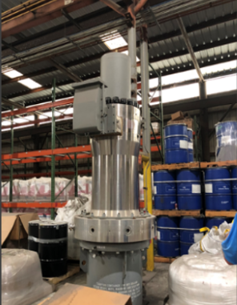
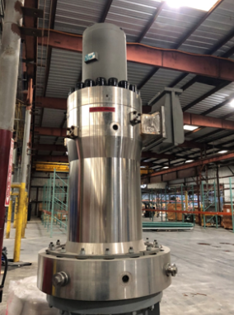
Surplus Flowserve catalyst recycle pump
Size: 3240psi discharge, 228psi Head, 138gpm, 281 BHP, 369 HP Motor
Material: Solid 347SS forged, cast modified impeller/diffuser - 316LSS with Tungsten carbide hard facing

Slide 13
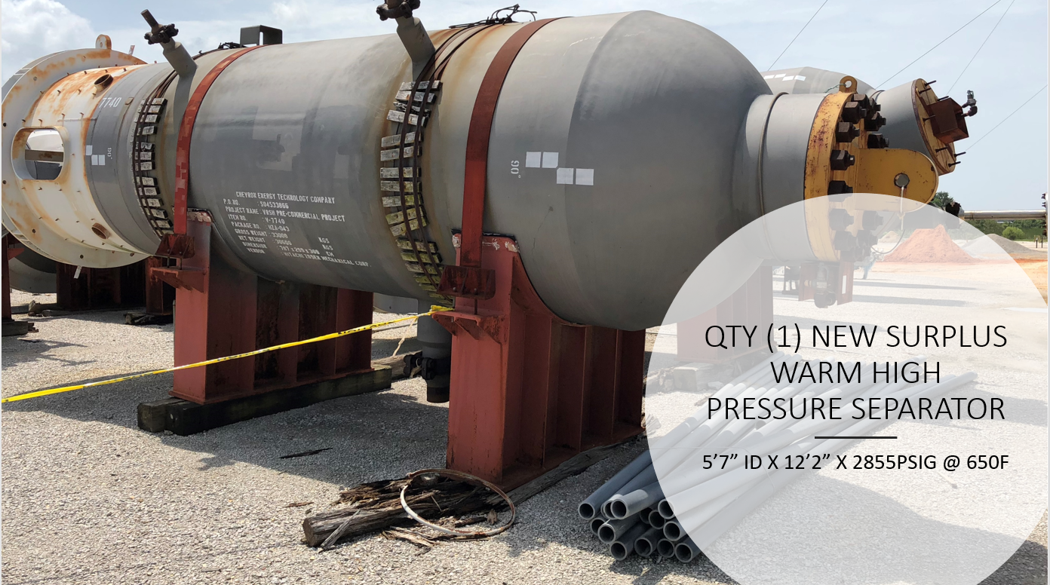
Surplus warm high-pressure separator

Slide 14
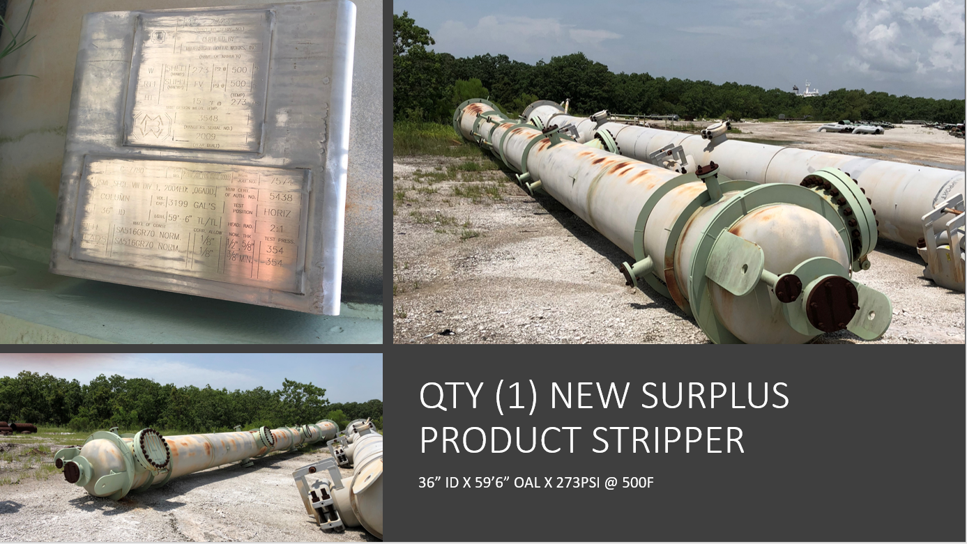
Surplus product stripper

Slide 15
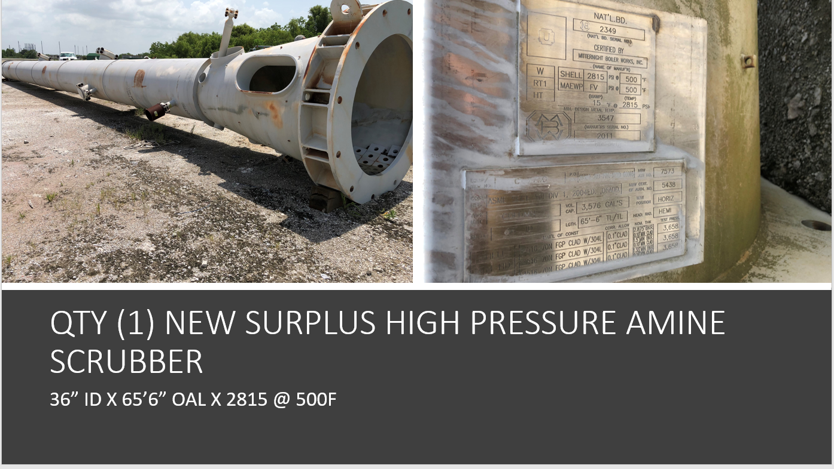
Surplus amine scrubber

Slide 16
For Additional Info:
Please call
Giseli Fritz - Vice President of Business
+1 (281)917-0194
Randy Pennington - President
+1 (713)898-5098
Giseli.fritz@nssseparation.com
Randypennington@Reagan.com
For the complete inventory of VRSH equipment, please visit: http://www.penrithenergy.com/products/available-surplus

